Slide 1
Agenda, 9-7-12
Journal Prompt: How would you deal with being falsely accused of a crime simply because of the way you look or because of the people that you are associated with?
Class Discussion
PowerPoint Presentation Introducing The Crucible, by Arthur Miller, and its historical context.
On Monday: WebQuest on Salem Witch Trials (examining actual court records).

Slide 2
Consider the Following:
How would these allegations impact your daily life, reputation, career and family?
Are these types of allegations fair? If not, why do they persist?
Who makes these types of rumors or accusations? Why?
How do the themes of "panic," "hysteria," "paranoia," and "intolerance" fit into the discussion?
How does this fit in with the belief that a person is "innocent until proven guilty" under American law?

Slide 3
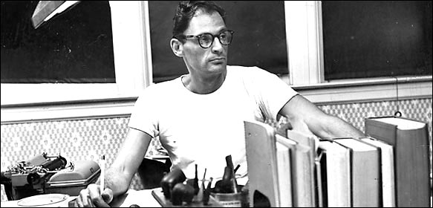
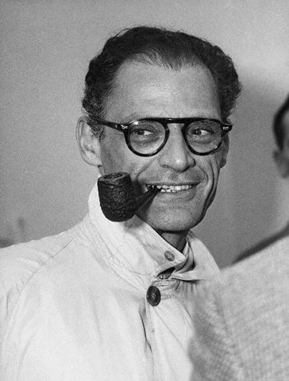
The Crucible
By Arthur Miller

Slide 4
What does ‘crucible’ mean?
cru·ci·ble (krs-bl)n.
1. A vessel made of a refractory substance such as graphite or porcelain, used for melting and calcining materials at high temperatures.
2. A severe test, as of patience or belief; a trial. See Synonyms at trial.
3. A place, time, or situation characterized by the confluence of powerful intellectual, social, economic, or political forces:

Slide 5
Who was Arthur Miller?
1915 – 2005
1915: Born in Harlem, NY, the son of an illiterate Jewish immigrant from Poland
1949: Miller publishes his play, The Death of a Salesman, which brought him fame. Like much of his work, it depicts how families are destroyed by false values.
Miller writes The Crucible in the early 1950s, when America is under the influence of the Red Scare. Following the end of WWII in 1946, the US entered the ‘Cold War’ with Russia, and both sides were developing nuclear arms with the potential to destroy the world. Russia’s Communism and America’s Democracy were ideas at war, and Americans considered them a grave threat.

Slide 6
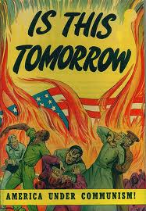
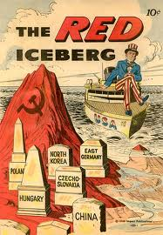
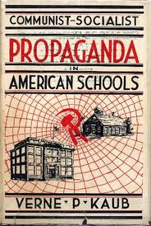
Red Scare Propaganda

Slide 7
Communism
Communism (from Latin communis - common, universal) is a revolutionary socialist movement to create a classless, moneyless, social order structured upon common ownership of the means of production, as well as a social, political and economic ideology that aims at the establishment of this social order.
Communist societies have existed in China, Russia, Poland, and in Cuba, and in many other countries over the last 100 years.

Slide 8
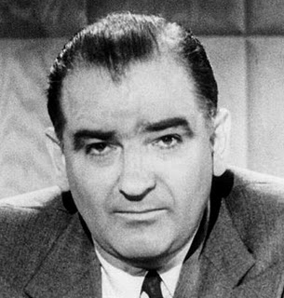
Joseph McCarthy and the Red Scare
Joseph McCarthy, a junior senator from Wisconsin, started spreading rumors that communism was infiltrating America and forming national security breaches. The fear he inspired caused an effort to subvert radical politics of any sort by equating it with being anti-American.
Thousands of Americans were brought up on suspicions of communist affiliations and asked to testify, an experience that caused many people to lose jobs, security, and to live in constant fear.
Radicals, even without ties to communism, were subjected to the communist witch hunt conducted by the House of Un-American Activities and Joseph McCarthy. Arthur Miller was one of them.

Slide 9
Pressure: Turn in your Friends, or you’ll be Next
During the Red Scare, people were encouraged to turn in anyone they knew who might be a Communist (or even have slight Communist sympathies).
In 1953, Ethel and Julius Rosenberg were executed for espionage; they were found guilty of providing sensitive security information to the Russians, including information on how to create the atomic bomb.
While evidence showed them to be guilty, many Americans believed they had an unfair trial due to hysteria of McCarthyism, and that the death penalty was too harsh..

Slide 10
Some videos…
http://www.youtube.com/watch?v=Cz1b2ybKbeo
(anti-Communist propaganda)
http://www.youtube.com/watch?v=1CbUZV24les&feature=related
The Hollywood Ten (1950)
http://www.youtube.com/watch?v=4gjf_8hxXx0
(on the Blacklist and Hollywood)

Slide 11
The Crucible is an Allegory:
Inspired by the similar spirit of these events with those of the Salem witch trials, Miller wrote The Crucible as a critique of contemporary American politics. IT WAS THE SAFE WAY TO REACT BY ‘CLOAKING’ IT IN HISTORY.
1953 The Crucible premiers
1956: Miller is called before the House Committee on Un-American Activities for refusing to offer other people's names, who had associated with leftist or suspected Communist groups. Miller was cited for contempt of Congress, but the ruling was reversed by the courts in 1958.

Slide 12
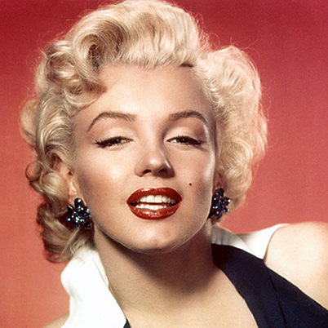
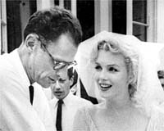
Factoid: Miller was married to Marilyn Monroe from 1956-61

