Slide 1
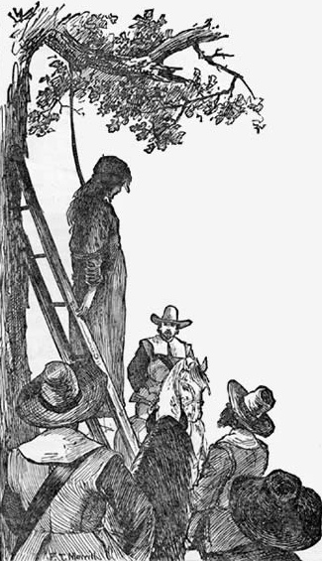
Logical Fallacies
in The Crucible

Slide 2
Today’s Guiding Questions
What part did faulty logic play in the Puritans’ ability to convict so many individuals of being witches without specific evidence?
Is faulty logic a part of everyday communication?

Slide 3
Have You ever heard these statements?
1. “Everyone cheats on their income taxes, so it must be all right.”
2. “America-love it or leave it!”
3. Mom: “Johnny, why did you fail math?”
Kid- “Because the teacher HATES me!”
4. Teen- “Dude, why does your baseball socks smell so bad?”
Smelly Teen: “These are my lucky socks. We never lose a game when I wear them.”

Slide 4
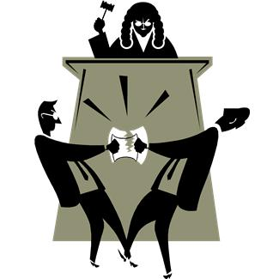
Logical fallacies
Fallacies are forms of flawed reasoning that are not logically sound and lead to faulty conclusions.

Slide 5
Post Hoc: "After this, therefore because of this."
A occurs before B.
Therefore A is the cause of B.
This fallacy is committed when it is concluded that one event causes another simply because the proposed cause occurred before the proposed effect.
I had been doing pretty poorly this season. Then my girlfriend gave me these neon laces for my spikes and I won my next three races. Those laces must be good luck...if I keep on wearing them I can't help but win!
Definition
Example

Slide 6
Ad Populum
Description of Appeal to Popularity
The Appeal to Popularity has the following form:
Most people approve of X (have favorable emotions towards X).
Therefore X is true.
Everyone smokes, so smoking is okay.
Definition
Example

Slide 8
Affirming the Consequent
Illogical reasoning that one consequence is the direct cause of one event absolutely, even if there is no correlating evidence. If A then B.
B takes place Therefore, A.
Definition
If it's raining, then the streets are wet.
The streets are wet.
Therefore, it's raining.
Example

Slide 9
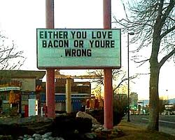
False Dilemma
If Guns are outlawed, only outlaws will have guns.
The arguer claims that there are only two options and one is unacceptable so we must accept the other. However in actuality there are other alternatives.
Definition
Example

Slide 10
Ad Hominem
The arguer suggests that her opponent’s view is unacceptable because of some negative character trait. Attack the person rather than the argument. Person A makes claim X.
Person B makes an attack on person A.
Therefore A's claim is false.
Sue argues that abortion should be outlawed.
Sue is accused of having an affair.
Sue should not be listened to.
Definition
Example

Slide 11
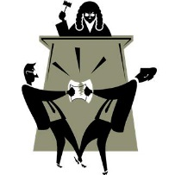
Red Herring
An irrelevant topic is presented in order to divert attention from the original issue.
Teen: Mom, can I go to a party tonight? Mom: How can I be sure you won't drink alcohol? Teen: Oh mom, how can you even think that when I've been doing homework all day!
Definition
Example

Slide 12
Oversimplification
The act of making something seem simpler than it really is
If we improved public education, then there would be no more poverty in America.
Definition
Example

